Slide 1
End-to-end conversational / agentic platform to design, test, and publish AI agents (copilots) using a no-code / low-code interface or pro-developer tools.
Agents can be embedded in Microsoft 365 Copilot (Teams, Outlook, SharePoint, M365 Chat) or exposed as standalone experiences/APIs
Uses Generative AI for multi-agent orchestration across tools, topics, and internal/external data sources.
Provides analytics & insights on conversations and generative answers to refine topics, tools, and knowledge.
Pros
Deep integration is ideal for knowledge workers in risk, compliance, and operations—agents live where employees work.
Supports the "Agentic Fabric" vision by allowing specialized agents to be composed into larger, sophisticated workflows.
Leverages existing Entra ID and tenant controls, with a strong roadmap emphasizing centralized governance and standardized deployment.
Cons
Requires heavy M365/Azure investment; integration to legacy core banking/mainframes demands middleware.
Features like multi-agent orchestration are new/evolving (public preview), requiring conservative rollout and model-risk oversight.
Weak governance poses a risk of security misconfiguration and potential abuse (e.g., token leakage).
Factor | Weight | Score* | Comment
Strategic Differentiation | 25% | 4 | Can become a cross-LOB knowledge + workflow layer (agents for risk, ops, HR, front-office support) inside tools everyone uses daily.
Risk, Compliance & Control | 25% | 4.5 | Strong enterprise controls & tenant governance; but multi-agent + “computer use” are new and require tight guardrails and mitigation of CoPhish-style risks.
Tech & Integration Fit | 20% | 4 | Excellent where M365 + Azure are standard; needs connectors/middleware for mainframes & niche banking systems.
Talent & Operating Model | 15% | 4 | Mix of citizen-dev (CoE-guided) and pro-dev fits how many banks run Power Platform today.
Economics & Time-to-Value | 10% | 4 | Fast time-to-value by reusing existing M365 licenses, data, and interfaces; incremental cost vs net-new SaaS.
Reuse & Platform Leverage | 5% | 4.5 | Agents and sub-agents can be reused across HR, IT, Ops, Risk, front office inside Copilot; strong platform leverage if standardized.
4.15

Slide 2
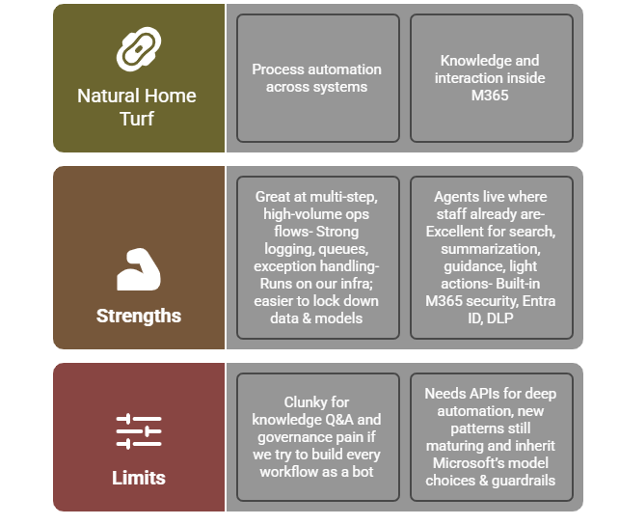

Slide 3
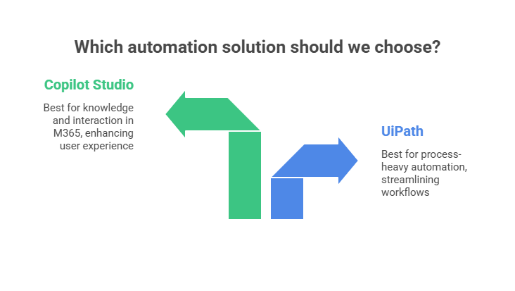
Neither should be stretched to be our only enterprise agentic platform.

Slide 4
Target Architecture
Central piece – CFG AI Platform
“Brain” and control plane for agentic AI.
Hosts the most sensitive models; enforces red-teaming, monitoring, and audit.
Orchestrates across:
Core banking & risk systems,
UiPath bots (for RPA/process tasks),
Copilot Studio agents (for M365-centric knowledge & light actions).
Domain Platforms (Integrated, not competing)
UiPath → Execution engine for structured, high-volume processes
KYC document handling, account maintenance, reconciliations, report runs, etc.
Copilot Studio → Interaction + knowledge layer in M365
IT/HR self-service, policy Q&A, “how do I” questions, guided front-office support.

